Slide 1


INFO
Identity a Painting’s Author by Learning from the Author’s Paintings
6105
LOGO
自在演示
Instructor:
Dr. Liu Handan
Authors:
Yi Ren
Fan Ji

Slide 2
Table of Contents
Instruction
Methodology
Description of Dataset
Results and Analysis
Conclusion
Reference

Slide 3
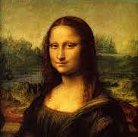
Introduction
BACKGROUND
Artistic creation is one of the highest forms of expression of human thought and imagination. Identifying the artist based on his or her artistic works is not that difficult for an enthusiast of arts. But can a computer do the same? Can a machine without emotions identify who the genius is behind a mind-blowing painting? The current art style learning research is mostly limited to the "mechanical transfer" technology of pixel-by-pixel and sample-by-sample features, but there is not much research and discussion about identifying the paintings through learning artistic style.

Slide 4
Our Goals: Identify the Artist from Paintings
01
02
03
Image Processing
Model Training
Application Development

Slide 5
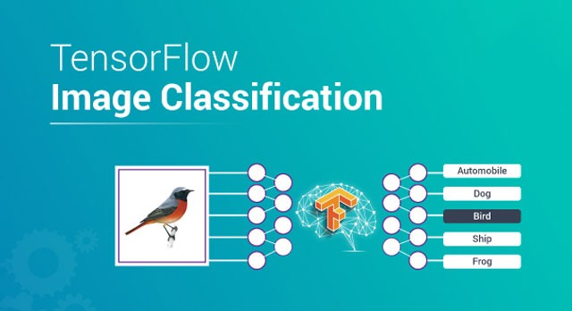
Our Goals: Identify the Artist from Paintings
Image Classification
We use TensorFlow to achieve the goal that identifying what an image represents

Slide 6
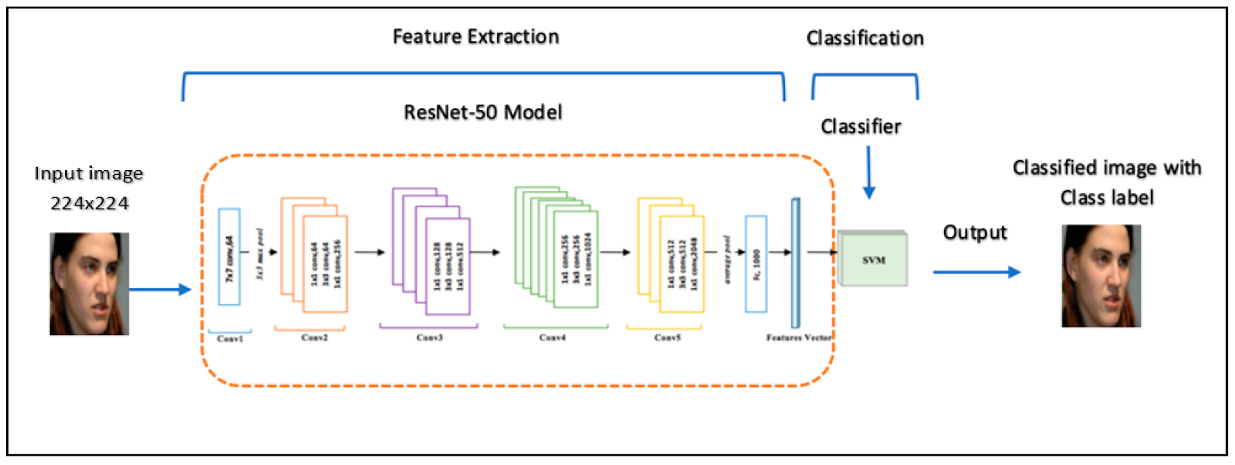
Our Goals: Identify the Artist from Paintings
Model Training
We apply ResNet50 model, where we mainly focus on training shallow layers rather than deep layers.

Slide 7
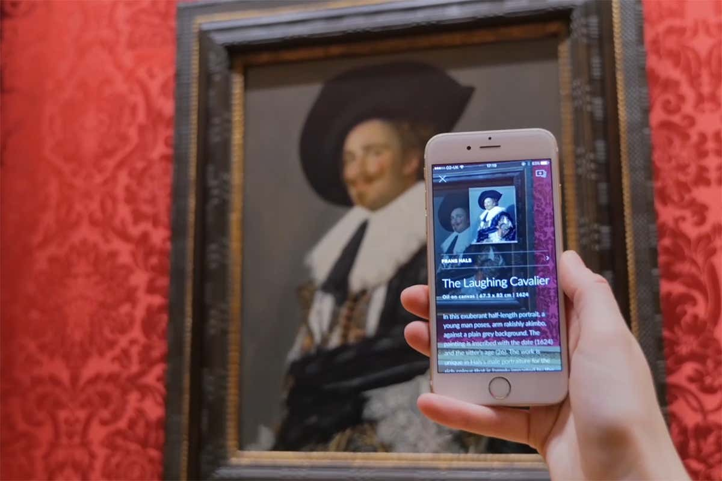
Our Goals: Identify the Artist from Paintings
Application Development
We want to develop an application in the future, which can be used in the gallery and museum to help people get to know the paintings in greater detail.

Slide 8
Methodology:
In this project, we use convolutional neural network-based approach, with a pre-defined architecture as baseline and ResNet50 to achieve the CNN. Why we choose to use the Keras in TensorFlow: Keras in TensorFlow has a lot of advantage and disadvantage. But as a beginner it is strong enough to finish the project. Keras is a more advanced and user-friendly API with a configurable backend, written and maintained by Francis Chollet, a member of the Google Brain team.

Slide 9
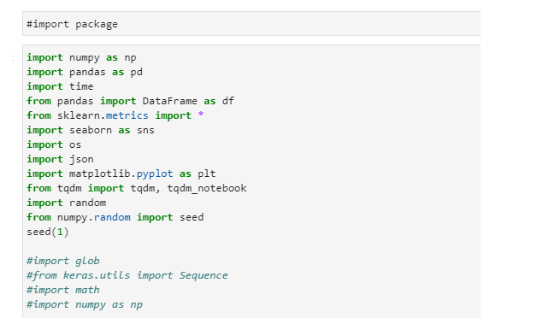
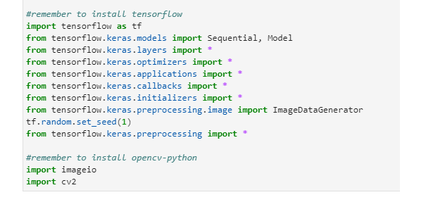
Problems and solutions:
Import Packages:

Slide 10
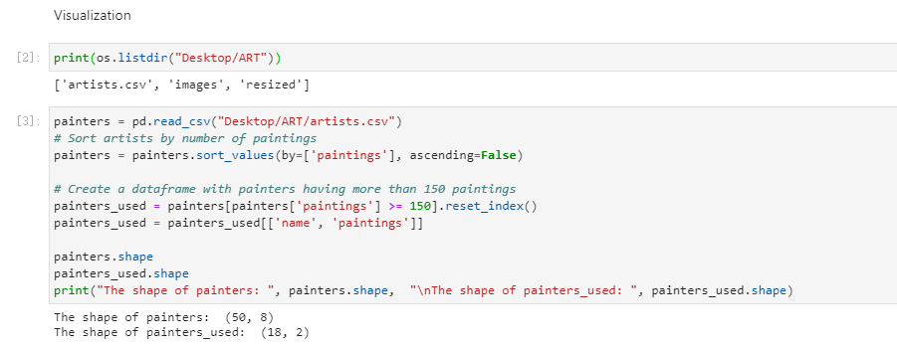
Visualization and data processing:

Slide 11
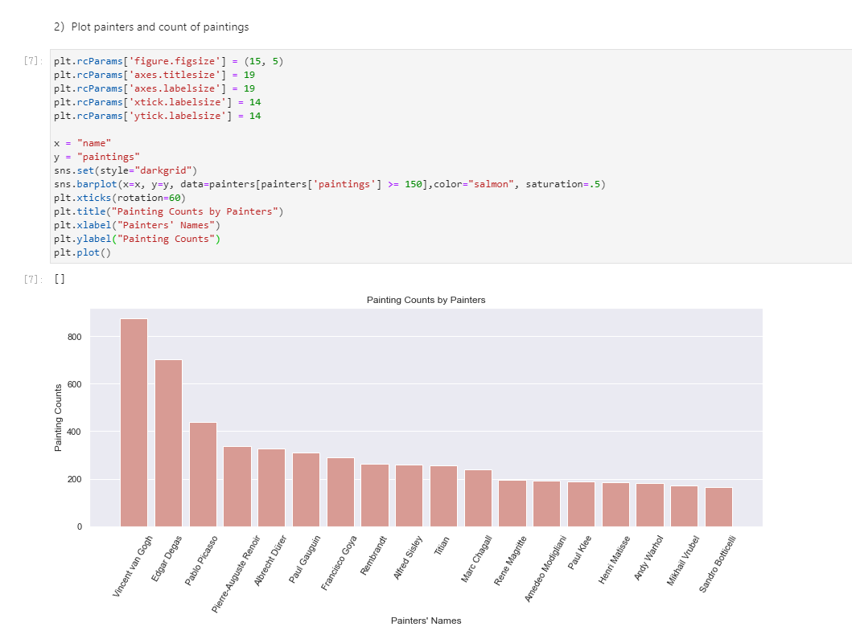
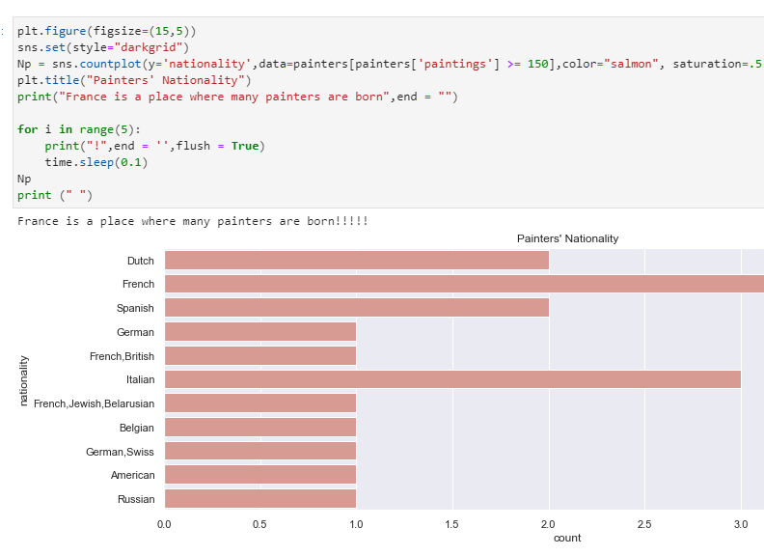
Visualization and data processing:

Slide 12
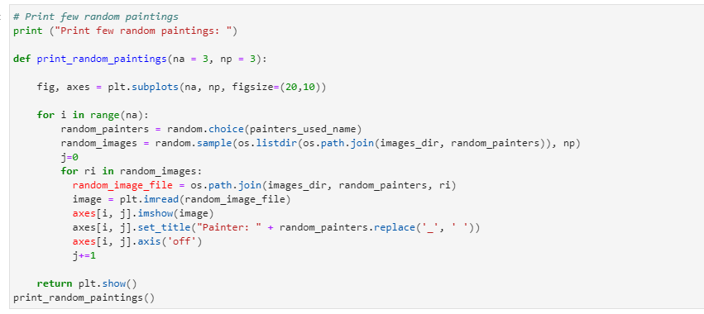
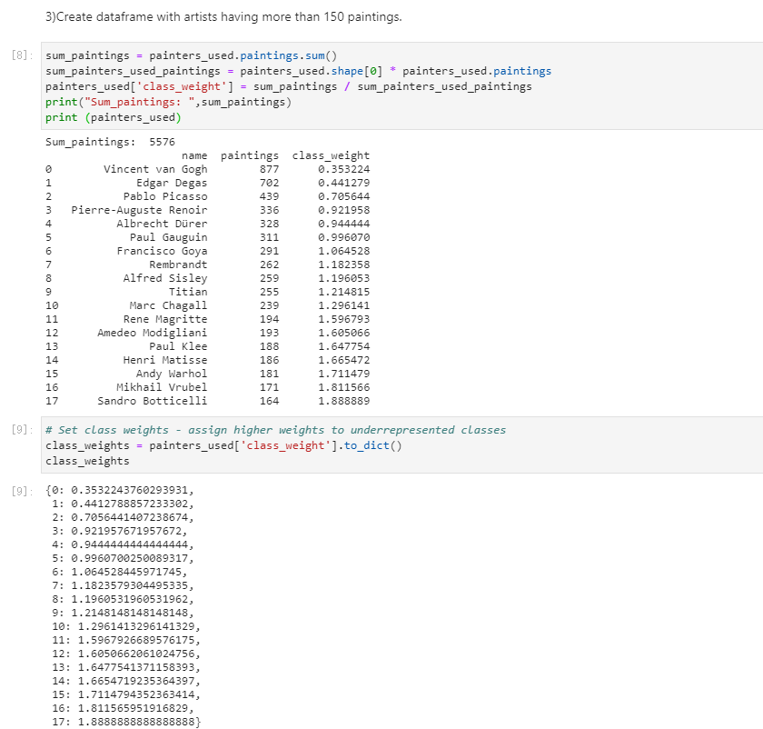
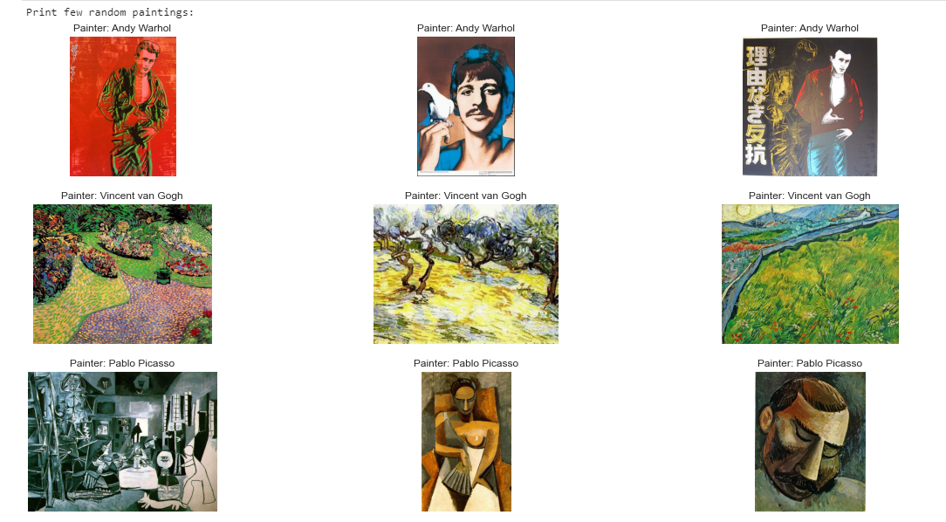
Visualization and Data Processing:

Slide 13
Data Processing
Three Main Purpose
Limit the dataset size and thus accelerate the model learning process
Remove noise from the data and improve the model predictive capabilities
Make the data interpretation easier by humans

Slide 14
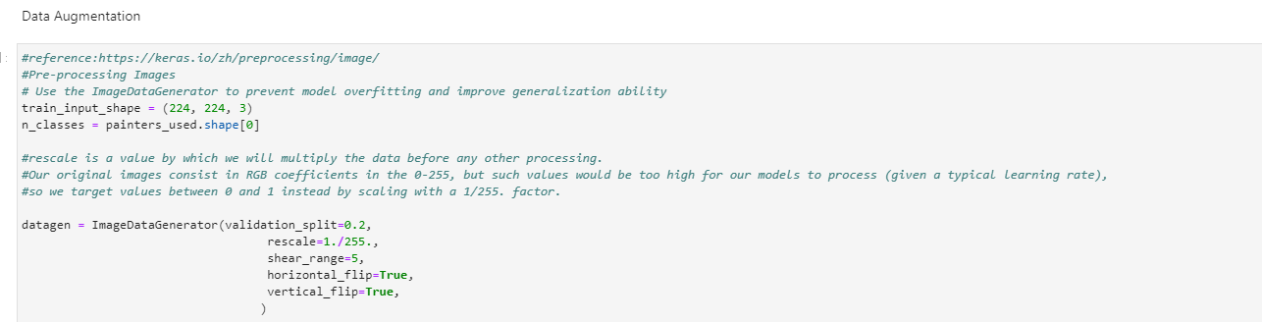
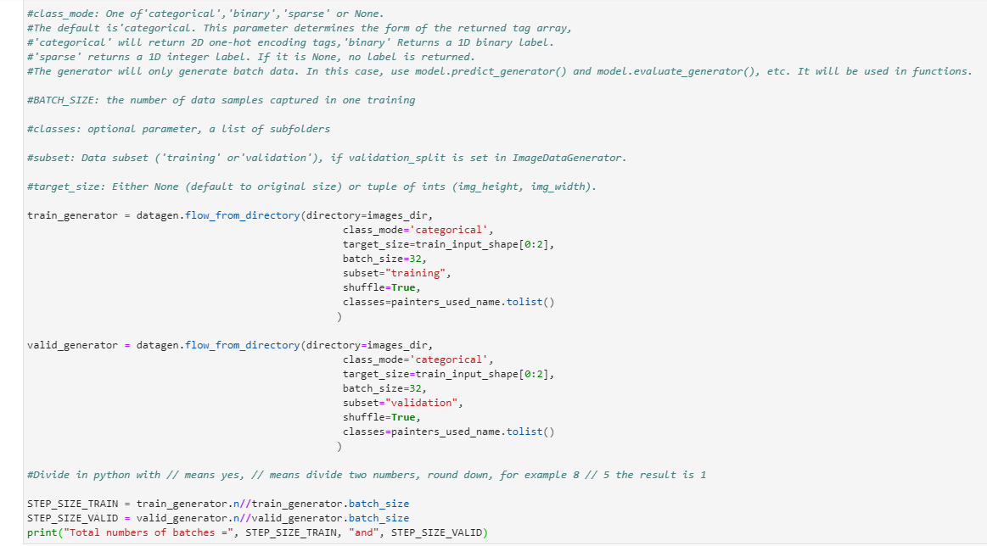
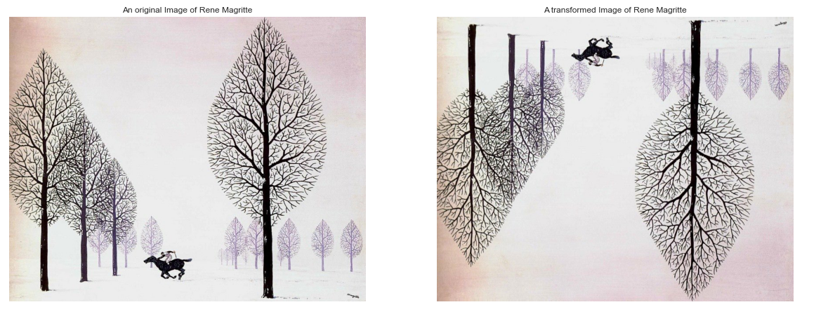
Data Augmentation:

Slide 15
Model Selection
Method | F1(%) | PRECISION | Recall(%) | Validation Accuracy(%)
VGGNet11 | 49.51 | 54 | 66.37 | 50.80
GoogLeNet | 76.21 | 76.64 | 76.53 | 76.54
ResNet18 | 63.34 | 66.37 | 66.44 | 66.45
ResNet50 | 77.84 | 66.37 | 78.02 | 79.62

Slide 16
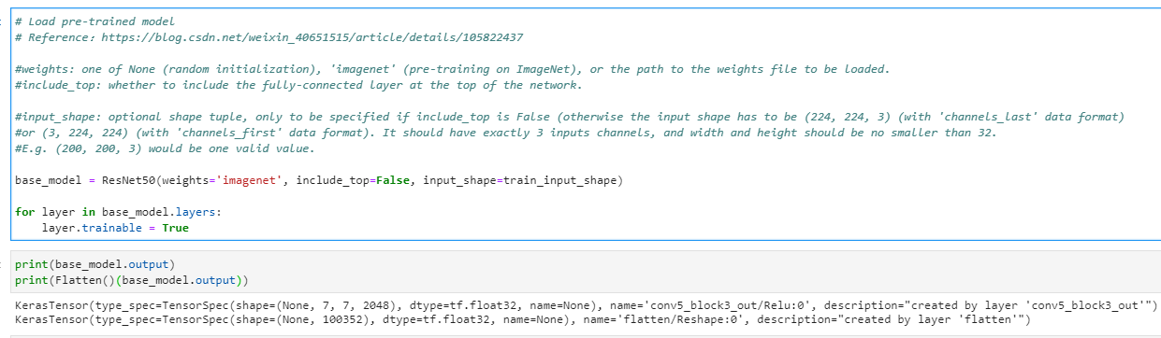
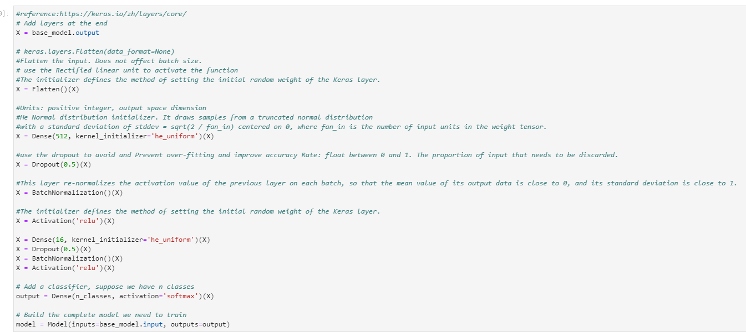
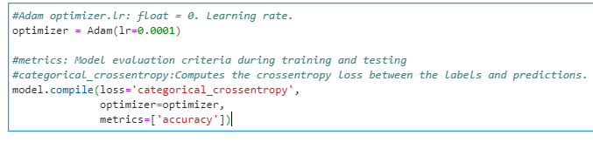
Build Module:

Slide 17
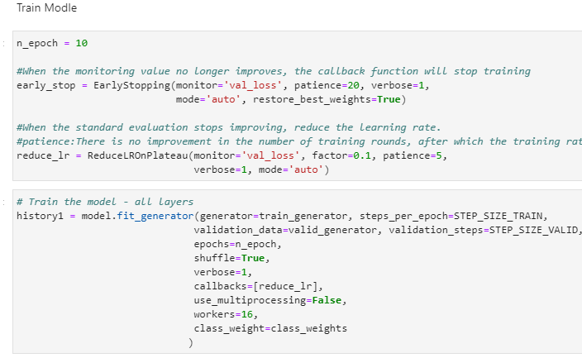
Train Model:
We use two methods to train the model. At first use all the layers turn on to train the model and then use the first fifty layers to train the model then add the results together as the final results. In order to improve the accuracy and to find out the influence of the n_epoch and the batch_size of the train result. We trained twice of both two method.

Slide 18
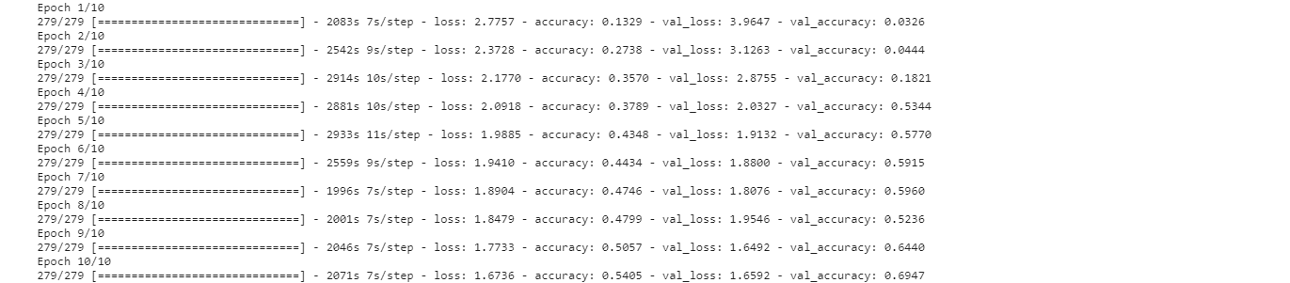
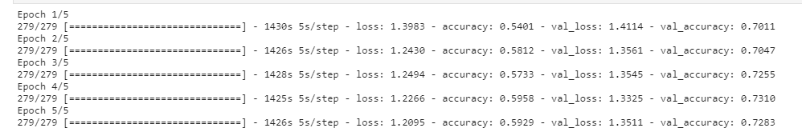
Train Model:
The first train results of all layers: Time: 6.674h
The first train results of the first fifty layers: Time: 1.982h

Slide 19
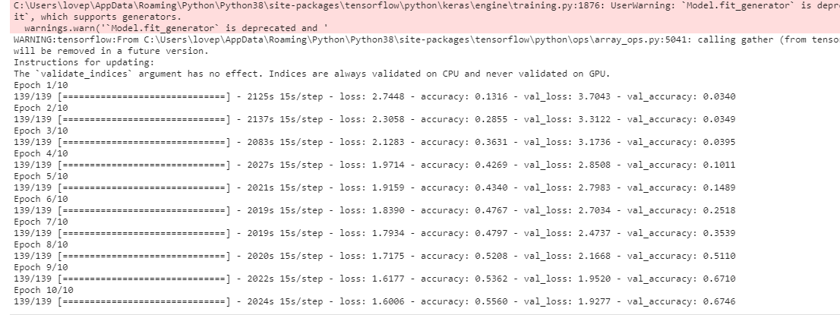
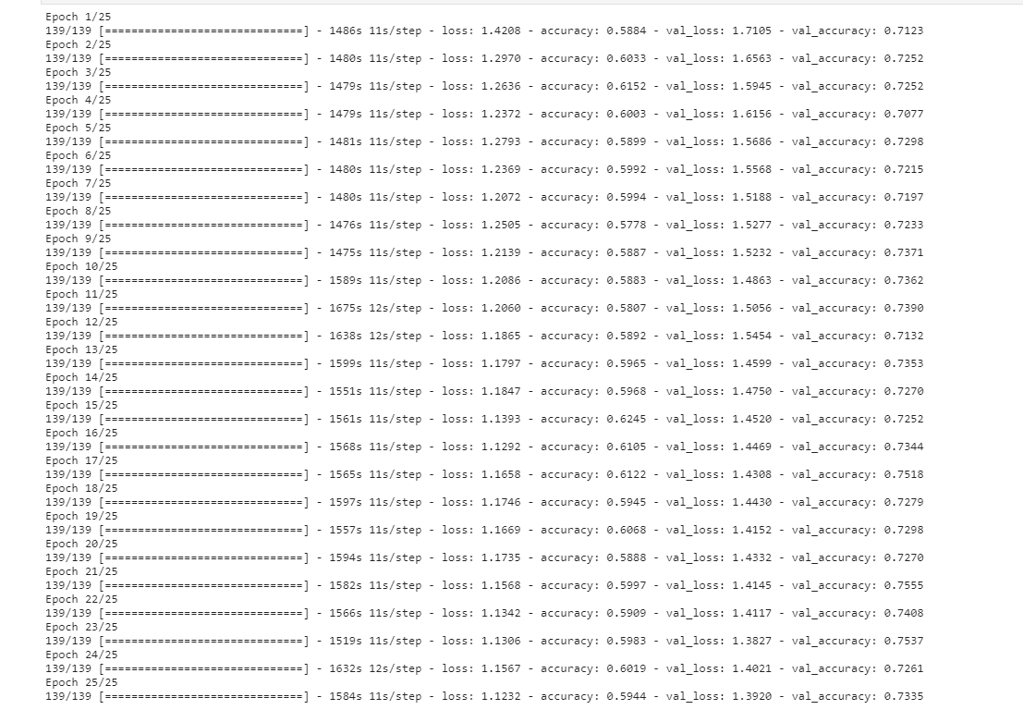
Train Model:
The second train results of the all layers: Time: 5.694h
The second train results of the first fifty layers: Time: 10.748h

Slide 20
Description of Dataset
Data Source
Dataset :Best Artworks of All Time
Link: https://www.kaggle.com/ikarus777/best-artworks-of-all-time
Contributor: Icaro
Data Source: artchallenge.ru
Time Scrapped: February 2019
Content: Artworks of the 50 most influential artists of all time
Files:
artists.csv: dataset of information for each artist, attributes include id, name, years, genre, nationality, bio, wikipedia and paintings.
images.zip: collection of images (full size), divided in folders and sequentially numbered
resized.zip: same collection but images have been resized and extracted from folder structure

Slide 21
Description of Dataset
Data Source
Dataset :Best Artworks of All Time
Link: https://www.kaggle.com/ikarus777/best-artworks-of-all-time
Contributor: Icaro
Data Source: artchallenge.ru
Time Scrapped: February 2019
Content: Artworks of the 50 most influential artists of all time
Files:
artists.csv: dataset of information for each artist, attributes include id, name, years, genre, nationality, bio, wikipedia and paintings.
images.zip: collection of images (full size), divided in folders and sequentially numbered
resized.zip: same collection but images have been resized and extracted from folder structure

Slide 22
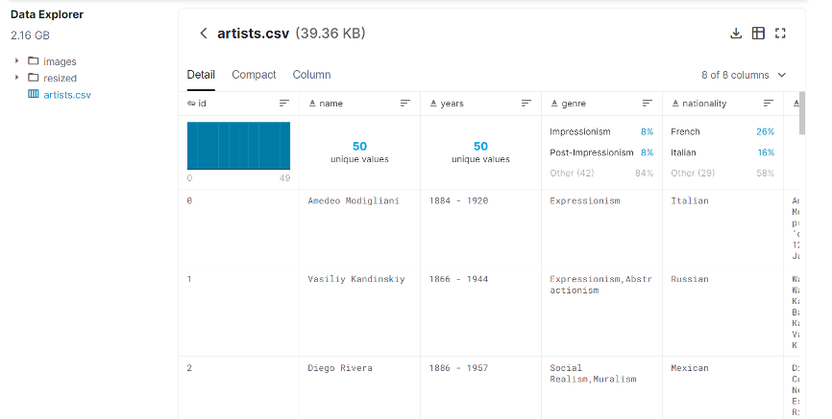
Description of Dataset
Data Overview

Slide 23
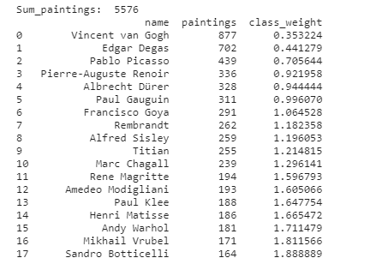
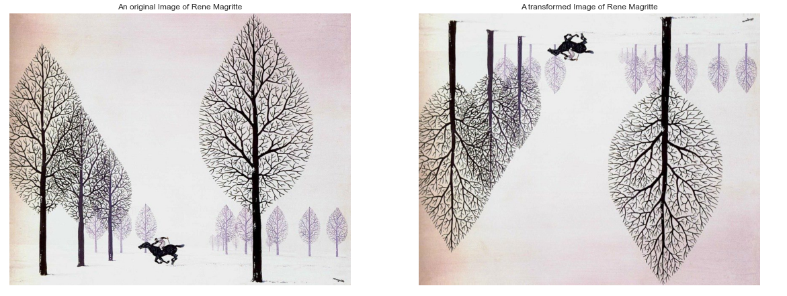
Description of Dataset
In the data cleaning process, we identified and corrected mistakes or errors in the data. We found some problem There is some problem recognizing 'Albrecht_Dürer’, So we'll update this string as directory name:
updated_name = "Albrecht_Dürer”. replace ("_", " ")
artists_top. iloc[4, 0] = updated_name

Slide 24
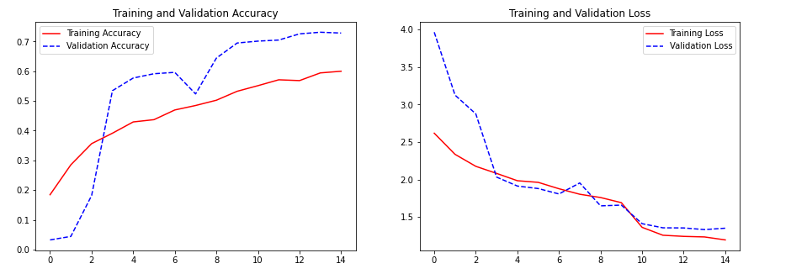
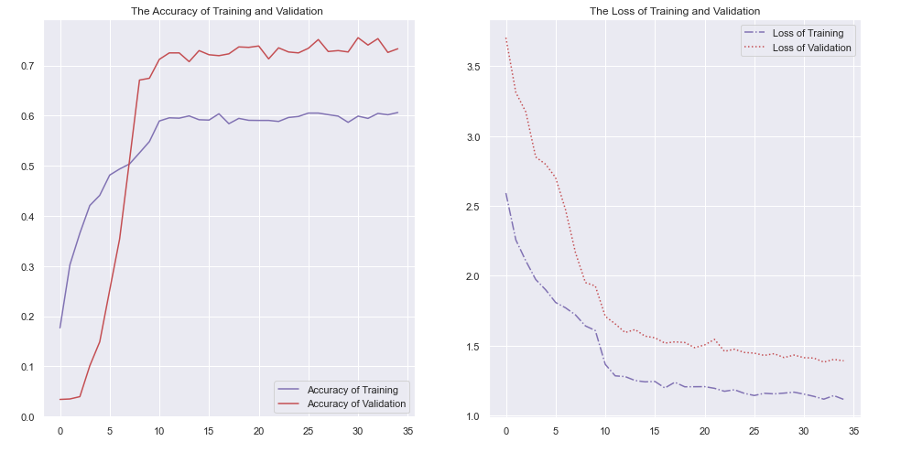
Results and Analysis:
Batch_size=16, epoch = 10 and epoch=5
Batch_size=32, epoch = 10 and epoch=25

Slide 25
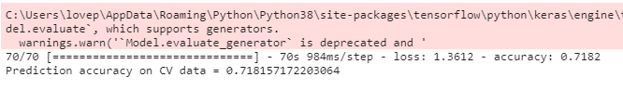
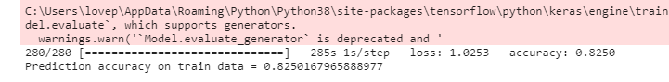
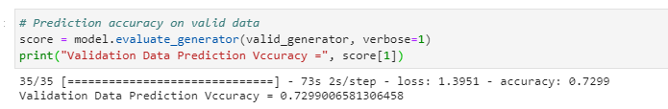
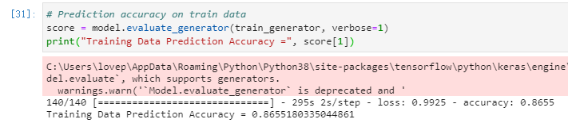
Batch_size=16, epoch = 10 and epoch=5
Batch_size=32, epoch = 10 and epoch=25

Slide 26
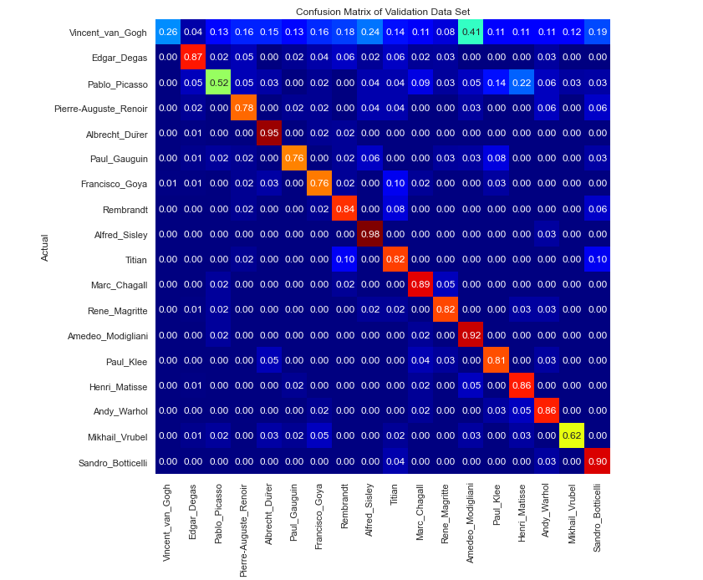
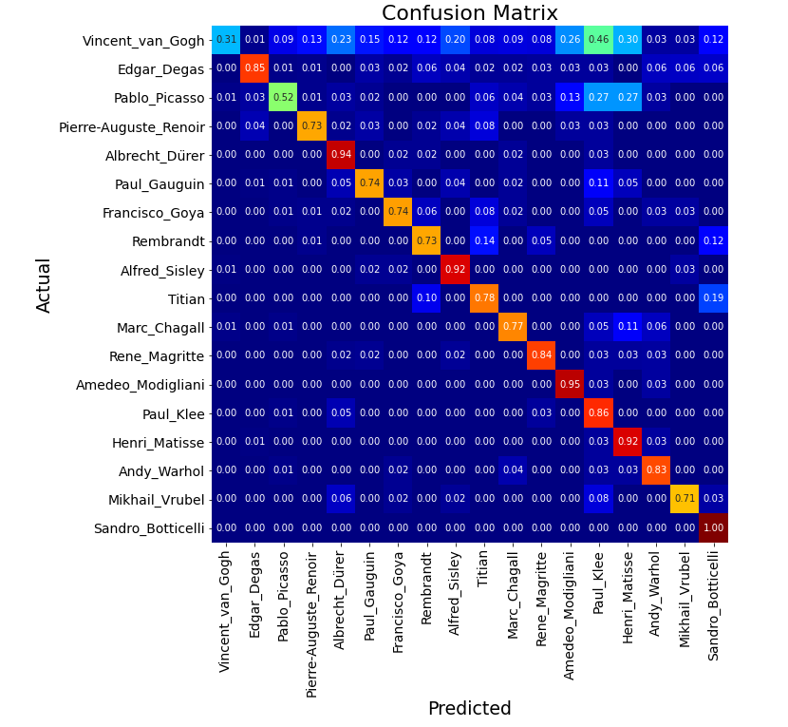
Different Two Validation Recall Confusion Matrix

Slide 27
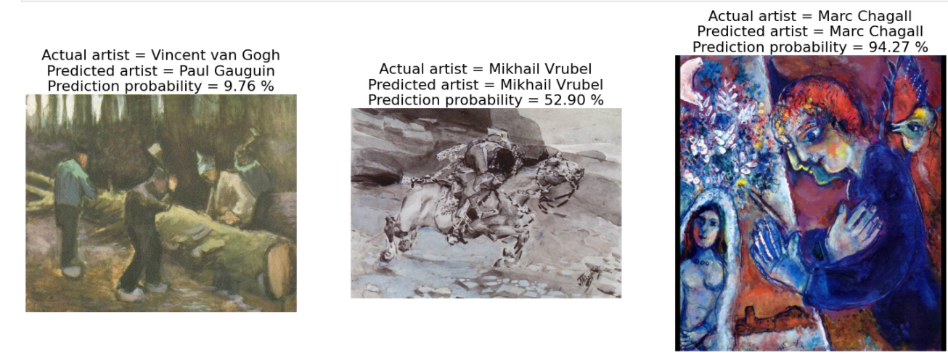
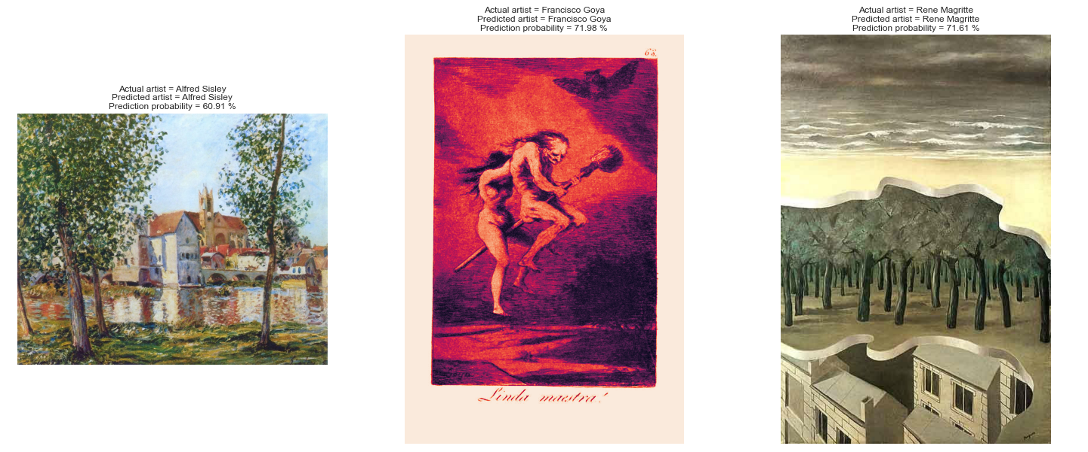
The Two Prediction Results

Slide 28
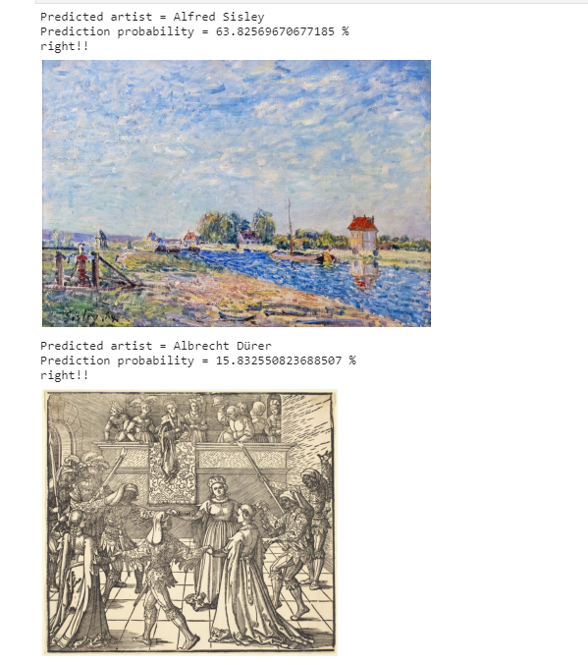
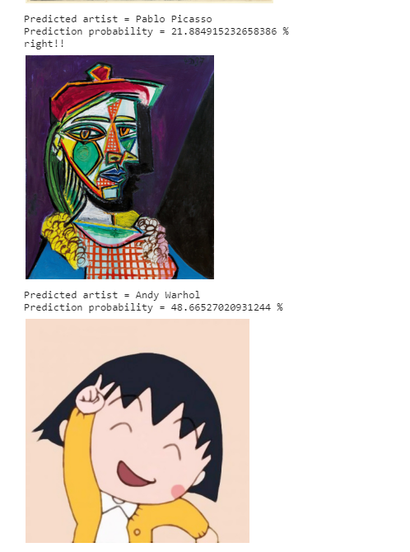
Use the Internet Resources to Verify our Model

Slide 29
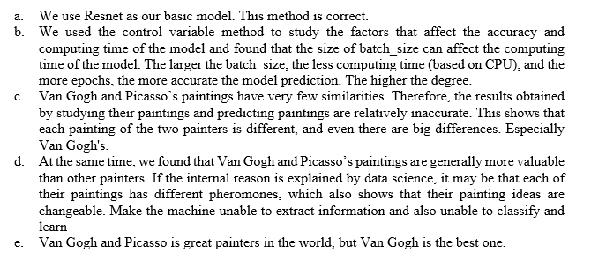
Conclusion:

Slide 30
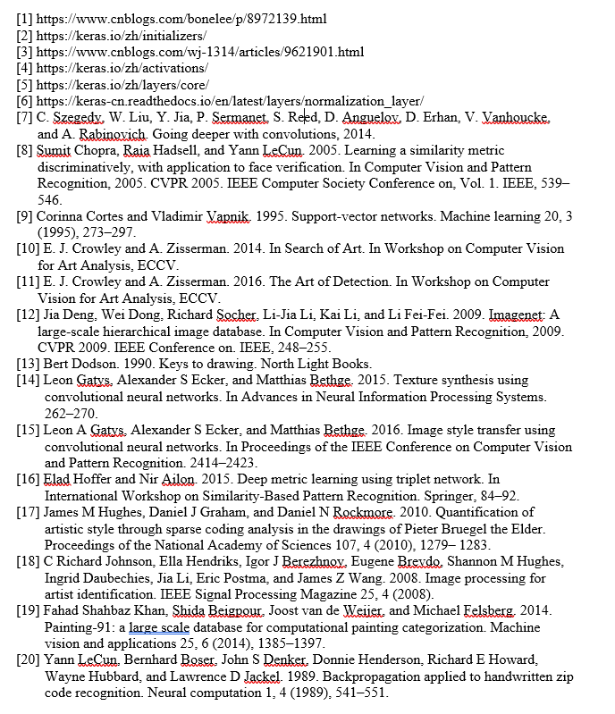
Reference:

Slide 31

THANKS

